Slide 1
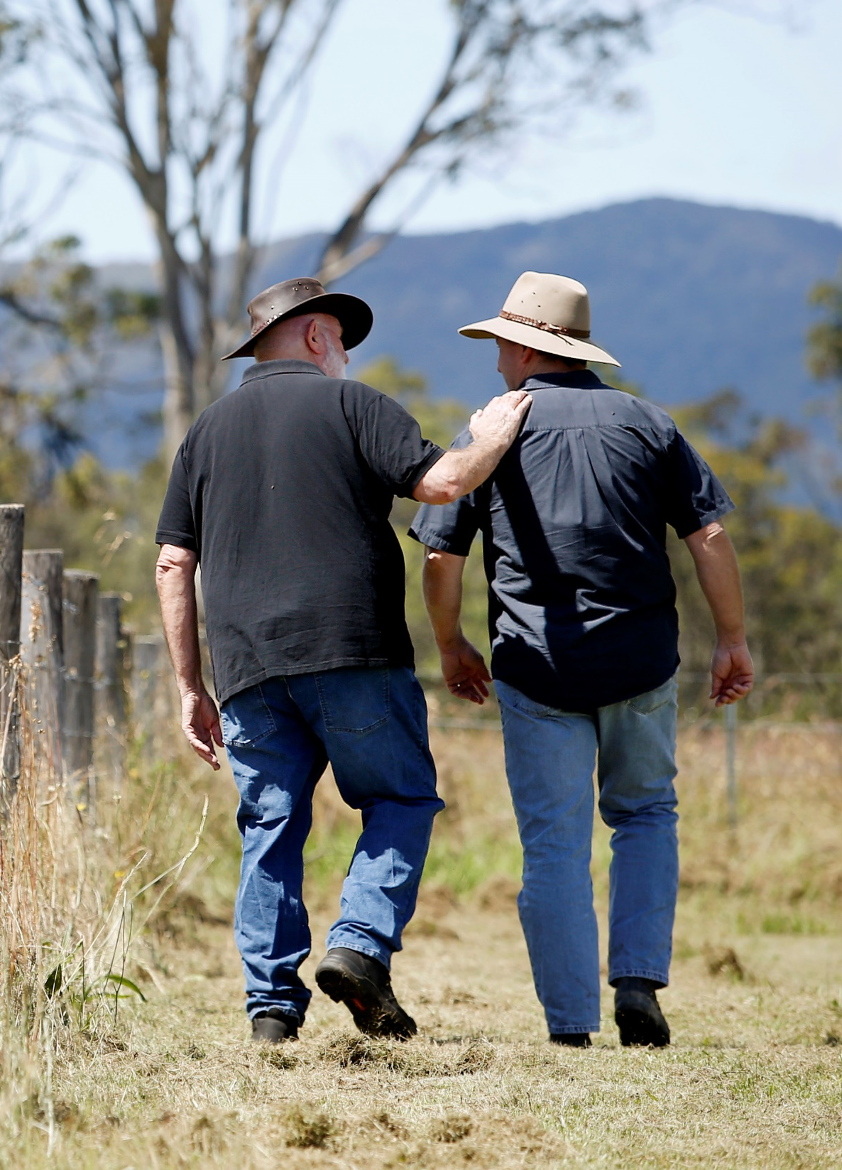
Some reflections on mental health research funding and the importance of Australian Rotary Health
Jane Pirkis

Slide 2
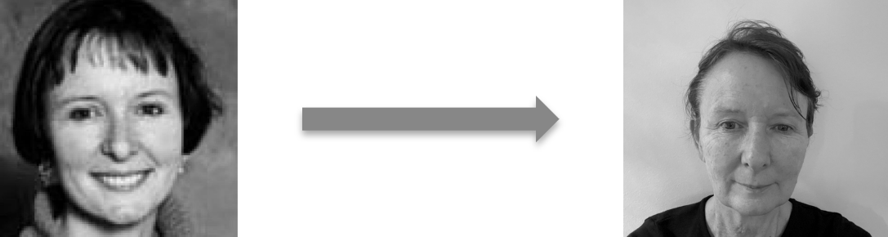
A bit about me …
Am the Director of the Centre for Mental Health and Community Wellbeing at the University of Melbourne
Joined the Australian Rotary Health Research Committee in 2007 and chaired it from 2017 to 2024
Attended my first Rotary meeting at the age of nine (and the roast chicken was excellent)
Have worked in mental health and suicide prevention research for 30 years

Slide 3

Australian Rotary Health

Slide 4



Since 2020 …
$
$40m
Research funding
742
Research grants
59
PhD scholarships
19
Postdoctoral fellowships

Slide 5

x2

Slide 7
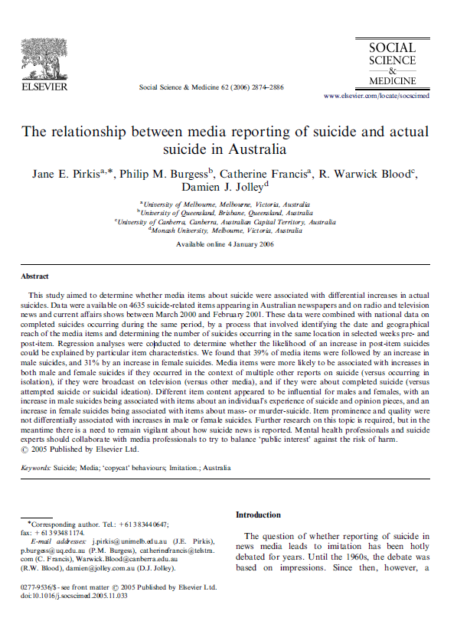
The grant
Collected data on 4,635 suicide-related articles appearing in Australian newspapers and on radio and television news and current affairs shows between March 2000 and February 2001
Combined these data with national data on suicides occurring during the same period
Found that 39% of the media articles were followed by an increase in male suicides and 31% by an increase in female suicides

Slide 8


Impacts
Guidelines widely used by journalists and editors (e.g., each year, the Mindframe website has >11,000 visits and >9,500 guideline downloads, >350 guideline training sessions are provided to media organisations, and guideline content is delivered in >30 journalism courses)
Well-established evidence that the guidelines have improved media reporting of suicide
Growing evidence that they can also reduce suicides

Slide 9


Slide 10
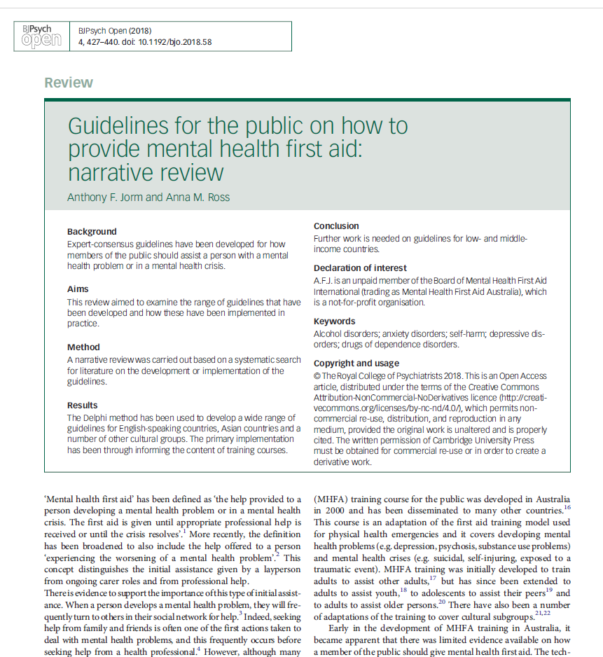
The grant
Series of Delphi studies
Sought consensus of expert clinicians, consumers and carers to develop “standards” for responding to six mental health crisis situations

Slide 11

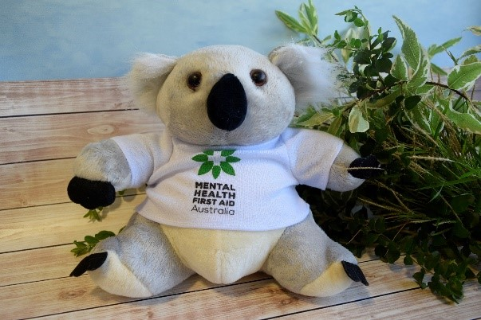
Impacts
Results informed the curriculum content of Mental Health First Aid courses
Since then:
  >8 million people have been trained in Mental Health First Aid worldwide, including >1.5 million in Australia
  Mental Health First Aid training is offered in 30 countries

Slide 12
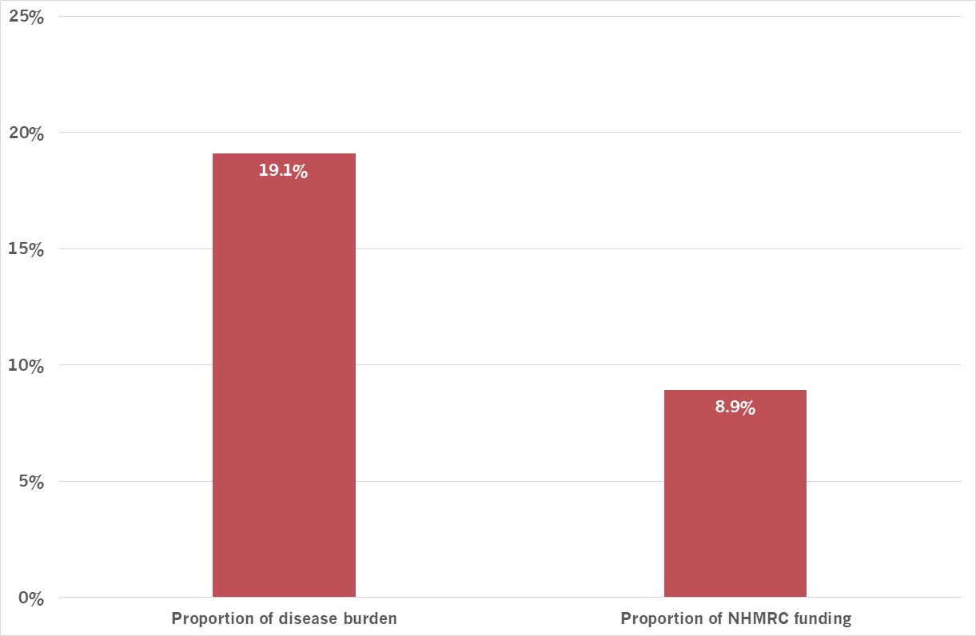

Mental health research in 2000
Australian Rotary Health has helped to fill this gap

Slide 13
Acknowledgements
Chairs of Australian Rotary Health
Stephen Humphreys (2024-current)
Kevin Shadbolt (2021-23)
Greg Ross (2018-20)
Jeff Crofts (2015-17)
Terry Grant (2012-14)
Noel Trevaskis (2010-11)
Terry Lees (2008-09)
Ian Oliver (2006-07)
John Ranieri (2004-05)
Denis Green (2002-03)
Terry Edwards (2000-01)
Ted Atkinson (1998-99)
Bruce McKenzie (1996-97)
Bruce Edwards (1994-95)
Colin Dodds (1991-93)
Geoffrey Betts (1988-90)
Royce Abbey (1982-87)
CEO
Joy Gillett OAM
1990-2025
Chairs of the Research Committee
Prof Phil Batterham (2025-current)
Prof Jane Pirkis (2017-24)
Prof Ron Rapee (2013-16)
Prof Tony Jorm (2009-12)
Prof Michael Sawyer (2004-08)
Dr John Feros (1999-2003)
Dr Clarrie Gluskie (1994-98)
Dr John Harley (1990-93)
Dr Alan Williams (1985-89)

